Slide 1
Syslog Analysis
Notes:
This lesson will take about 30 minutes to complete.

Slide 2
Lesson objectives
After completing this lesson you will be able to:
Interpret information collected using the ACsyslog tool
Notes:
Related Documentation
Mediant 3000 SIP User's Manual
EMS Parameter Guide for the Mediant 5000 and Mediant 8000 Gateways
Mediant™ and 5000/8000 and IPmedia 8000™ Command Line Interface (CLI) Reference Guide
EMS Parameter Guide for Mediant 1000, Mediant 2000, Mediant 3000, IPmedia 3000 and IPmedia 2000
Product Reference Manual for SIP CPE Devices
EMS Parameter Guide for MediaPack

Slide 3
What is Syslog?
Syslog is a standard for collecting log messages within an IP network.
A Syslog server can be used to remotely record log information.
Sent to a central server using UDP port 514
Ensure this port is open in your firewall if central server is outside the local network
Syslog information that is sent by the gateway is a collection of error, warning, and system messages that can record almost every internal operation of the gateway.
Syslog protocol defined in the IETF RFC 3164
Notes:
Syslog Support
Syslog protocol is an event notification protocol that enables a machine to send event notification messages across IP networks to event message collectors, also known as Syslog servers. The Syslog protocol is defined in the IETF RFC 3164 standard.
Since each process, application, and operating system was written independently, there is little uniformity in Syslog messages. For this reason, no assumption is made on the contents of the messages other than the minimum requirements of its priority.
Syslog uses UDP as its underlying transport layer mechanism. By default, UDP port 514 is assigned to Syslog, but this can be changed (using the SyslogServerPort parameter).
The Syslog message is transmitted as an ASCII (American Standard Code for Information Interchange) message.
The message starts with a leading less-than character (‘<’), followed by a number, which is followed by a greater-than character (‘>’).
This is optionally followed by a single ASCII space.
The number is known as the Priority and represents both the Facility and Severity as described below.
The Priority number consists of one, two, or three decimal integers.

Slide 4
Collecting Data
When reporting a problem to AudioCodes support, the following information should be provided:
Network setup (such as network diagram, call direction)
Board.ini file (renamed appropriately for your site)
Unfiltered Syslog trace (ACsyslog best tool to use with AudioCodes products)
Unfiltered WireShark files
Advanced Debug Recordings (per AudioCodes request):
Examples:
PSTN signaling problems
Problems related to voice quality, modem, fax, DTMF detection
Notes:
Notes:

Slide 5
Collecting INI file – Web interface
To save the .ini file:
Open the 'Configuration File' page (Management tab > Software Update menu > Configuration File).
To save the ini file to a folder on your PC:
Click the Save INI File button; the 'File Download' dialog box appears.
Click the Save button, navigate to the folder in which you want to save the ini file on your PC, and then click Save; the device copies the ini file to the selected folder.
Notes:
Backing Up and Restoring Configuration
Usually AudioCodes Technical Support needs the “INI file”, not the “Complete INI file”. If the complete file is needed, it will be specifically requested.
The “INI File” contains only the parameters that have been set differently from the default settings.
The “Complete INI File” contains every parameter. This is a very large file.
You can save a copy/backup of the device current configuration settings as an ini file to a folder on your PC, using the 'Configuration File' page.
The saved ini file includes only parameters that were modified and parameters with other than default values.
The 'Configuration File' page also allows you to load an ini file to the device. If the device has "lost" its configuration, you can restore the device's configuration by loading the previously saved ini file or by simply loading a newly created ini file.
Note: When loading an ini file using this Web page, parameters not included in the ini file are reset to default settings.

Slide 6
Syslog Servers
You can use the supplied proprietary Syslog server ACSyslog or any other third-party Syslog server for receiving Syslog messages.
A typical Syslog server application enables filtering of messages according to:
Priority
IP sender address
Time
Date
Notes:
Notes:
Syslog is a standard for logging program messages.
It allows separation of the software that generates messages from the system that stores them and the software that reports and analyzes them.
It also provides devices, which would otherwise be unable to communicate, a means to notify administrators of problems or performance.
Configuration allows directing messages to various local devices (console), files (/var/log/) or remote syslog daemons. Care must be taken when updating the configuration; omitting or misdirecting message facility.level can cause important messages to be ignored by syslog or overlooked by the administrator.
Syslog is now standardized within the Syslog working group of the Internet Engineering Task Force (IETF).

Slide 7
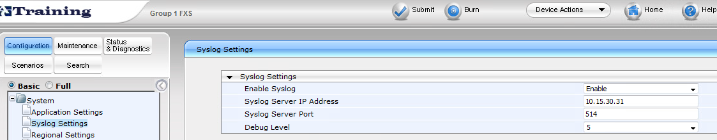
Log Verbosity Levels – MediaPack 11X, 124
0 = Disabled (default)
1 = Flow
5 = Flow, device interface, stack interface, session manager and expanded device interface
7 = automatically changes between level 5, level 1 and level 0, depending on the device CPU consumption
Note: AudioCodes support REQUIRES level 5 logs be captured for support requests
Notes:
New in release 6.0:
Automatic Syslog Debug Level Selection Based on CPU Usage:
The device now supports a new debug level of 7. When set to this level, the Syslog level automatically changes between level 5, level 1 and level 0, depending on the device CPU consumption.
In addition, to improve device performance, several Syslog messages are now merged and sent as a single UDP datagram.
A new parameter, MaxBundleSyslogLength defines the maximum size of this bundled UDP packet.
The maximum size (in bytes) threshold of logged, bundled (into a single UDP packet) Syslog messages, after which they are sent to a Syslog server.
The valid value range is 0 to 1220 (where 0 indicates that no bundling occurs). The default is 1220.
Note: This parameter is applicable only if the GWDebugLevel parameter is set to 7.
Relevant parameters: GWDebugLevel; MaxBundleSyslogLength.

Slide 8
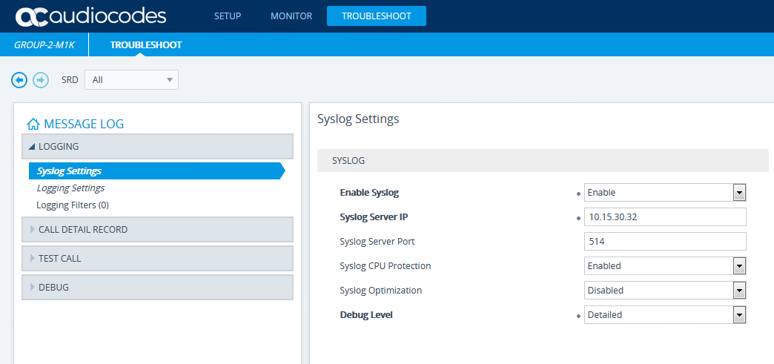
Log Verbosity Levels – Mediants/MP-1288 Pre 7.2.250
NoDebug = Disabled (default)
Basic = Flow
Detailed = Flow, device interface, stack interface, session manager and expanded device interface
Syslog CPU Protection - Enabled = automatically changes between level 5, level 1 and level 0, depending on the device CPU consumption
Note: AudioCodes support REQUIRES Detailed logs be captured for support requests
Notes:
New in release 6.0:
Automatic Syslog Debug Level Selection Based on CPU Usage:
The device now supports a new debug level of 7. When set to this level, the Syslog level automatically changes between level 5, level 1 and level 0, depending on the device CPU consumption.
In addition, to improve device performance, several Syslog messages are now merged and sent as a single UDP datagram.
A new parameter, MaxBundleSyslogLength defines the maximum size of this bundled UDP packet.
The maximum size (in bytes) threshold of logged, bundled (into a single UDP packet) Syslog messages, after which they are sent to a Syslog server.
The valid value range is 0 to 1220 (where 0 indicates that no bundling occurs). The default is 1220.
Note: This parameter is applicable only if the GWDebugLevel parameter is set to 7.
Relevant parameters: GWDebugLevel; MaxBundleSyslogLength.

Slide 9
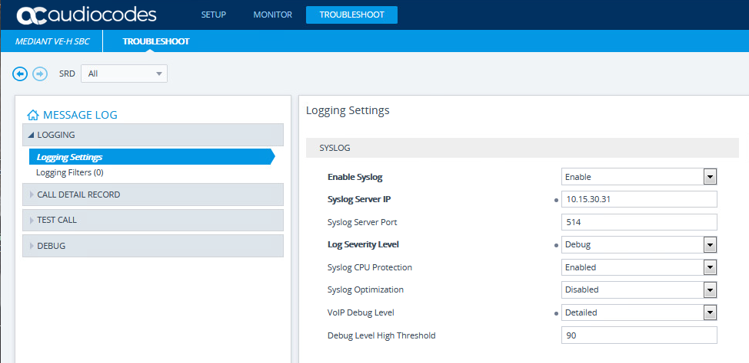
Log Verbosity Levels – Mediants/MP-1288
VoIP Debug Level replaces Debug Level for Syslogs
NoDebug = Disabled (default)
Basic = Flow
Detailed = Flow, device interface, stack interface, session manager and expanded device interface
Syslog CPU Protection - Enabled = automatically changes between level 5, level 1 and level 0, depending on the device CPU consumption
Note: AudioCodes support REQUIRES Detailed logs be captured for support requests
Notes:
New in release 6.0:
Automatic Syslog Debug Level Selection Based on CPU Usage:
The device now supports a new debug level of 7. When set to this level, the Syslog level automatically changes between level 5, level 1 and level 0, depending on the device CPU consumption.
In addition, to improve device performance, several Syslog messages are now merged and sent as a single UDP datagram.
A new parameter, MaxBundleSyslogLength defines the maximum size of this bundled UDP packet.
The maximum size (in bytes) threshold of logged, bundled (into a single UDP packet) Syslog messages, after which they are sent to a Syslog server.
The valid value range is 0 to 1220 (where 0 indicates that no bundling occurs). The default is 1220.
Note: This parameter is applicable only if the GWDebugLevel parameter is set to 7.
Relevant parameters: GWDebugLevel; MaxBundleSyslogLength.

Slide 10
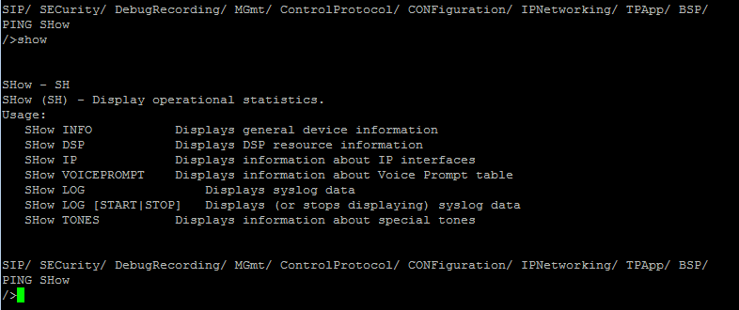
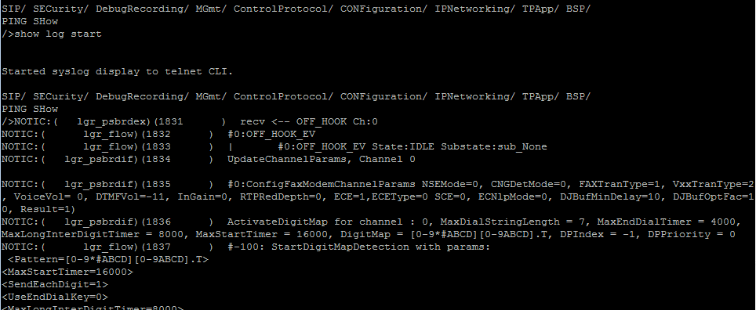
Online Syslogs via RS-232 and Telnet via CMD SHELL
Once syslog is enabled, the logs are visible in both the console and telnet sessions
Enable SSH or telnet on the gateway and log in using Putty or similar tool
The commands to start and stop collecting logs are:
show log start
show log stop
Log the session to a text file to capture the full trace on your local PC
Notes:
Notes:

Slide 11
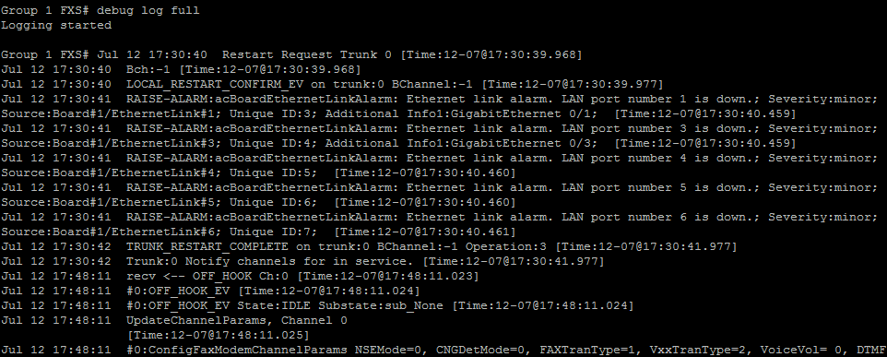
Online Syslogs via RS-232 and Telnet via CLI
Once syslog is enabled, the logs are visible in both the console and telnet sessions
Enable SSH or telnet on the gateway and log in using Putty or similar tool
The commands to start collecting logs is:
debug log
debug log full
Log the session to a text file to capture the full trace on your local PC
Notes:
Notes:

Slide 12
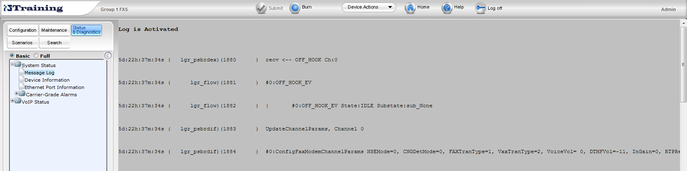
Online Syslogs via Web Browser Message Log MP 11X MP 124
Once syslog is enabled, the logs are visible in both the console and telnet sessions
Access Status & Diagnostics -> System Status -> Message Log
Logs temporarily stored in PC/Macs RAM
Notes:
Notes:

Slide 13
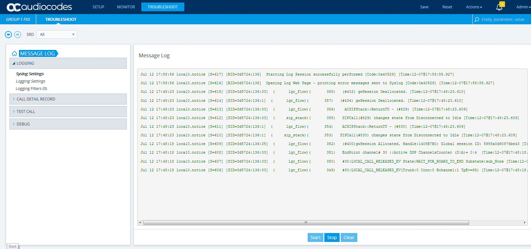
Online Syslogs via Web Browser Message Log Mediants MP-1288
Once syslog is enabled, the logs are visible in both the console and telnet sessions
Access Troubleshoot -> Troubleshoot -> MESSAGE LOG
Logs temporarily stored in PC/Macs RAM
Start/Stop/Clear used to prevent syslogs from eating all of the PC/Macs RAM
Notes:
Notes:

Slide 14

ACSyslog
ACSyslog is a free utility to capture AudioCodes Syslogs
Installation required
Requests updates when started each time
Use on as many workstations as you want
Contains many options and configuration parameters making it a robust tool for capturing debug logs
Notes:
Notes:

Slide 15
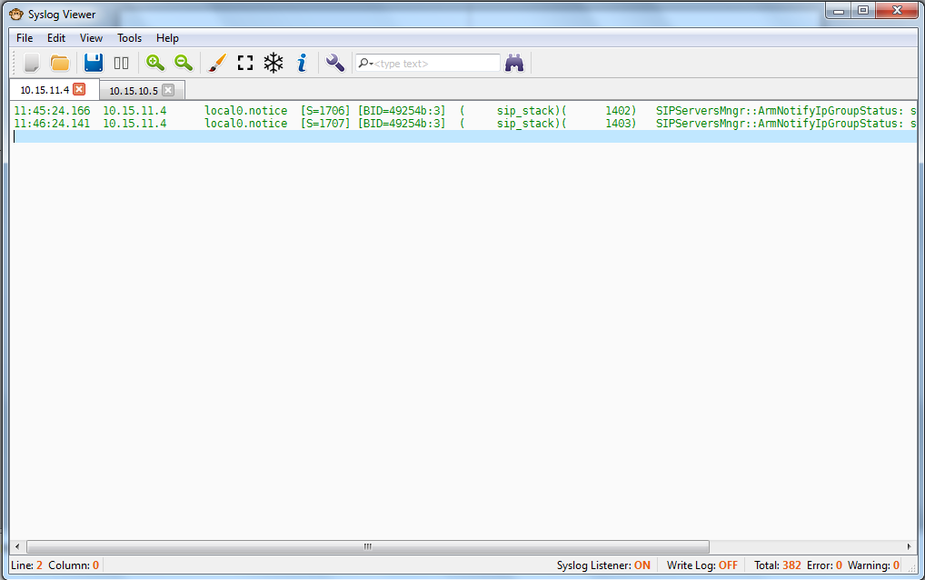
AudioCodes Syslog Viewer
A newer Syslog application provided with the student utilities kit

Slide 16
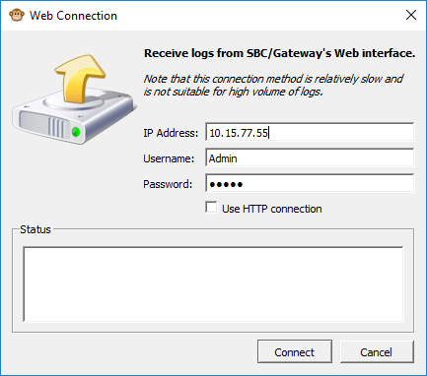


AudioCodes Syslog Viewer
Flow Diagram
Stop/Start Writing Log
Clear On-Line
Syslog
Zoom In/Out
Disable Auto scroll
Options
Search Text
Open Saved File
Open External Viewer
Freeze Display
Search Options
Search
Pause/Resume Logging
Number of Warning Messages in the Log File
Total Number of lines in the Log File
UDP/TCP Connection

Slide 17

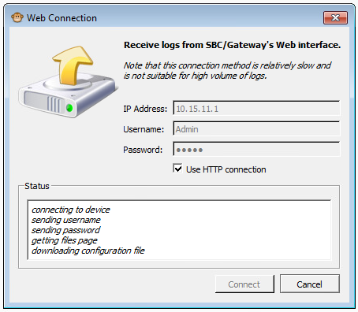
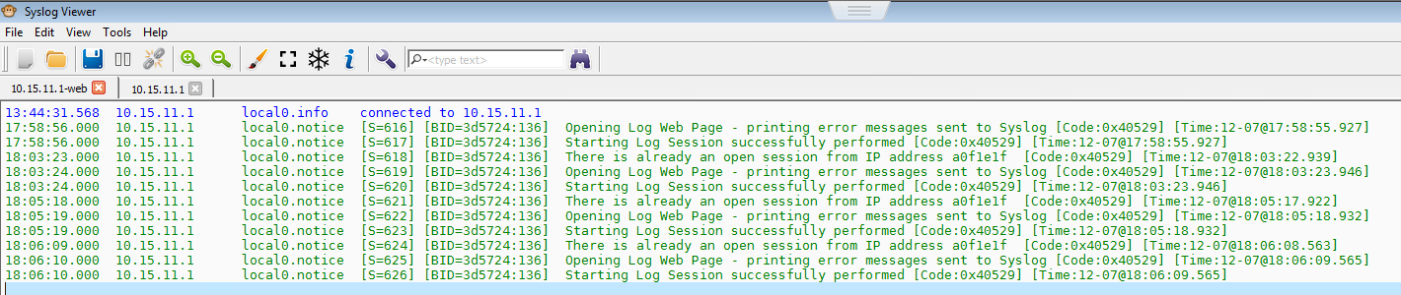
AudioCodes Syslog Viewer – connect from PC to GW/SBC using Web Connection
Connecting from ACSyslog to PC
Click Connect to link
Input IP address, Username and Password of SBC/GW
Logs recorded by Web Connection appear with –web in the display tab (Only 1 web connection can be monitored)
ACSyslog connected to Specific SBC/GW shown in lower right corner

Slide 18
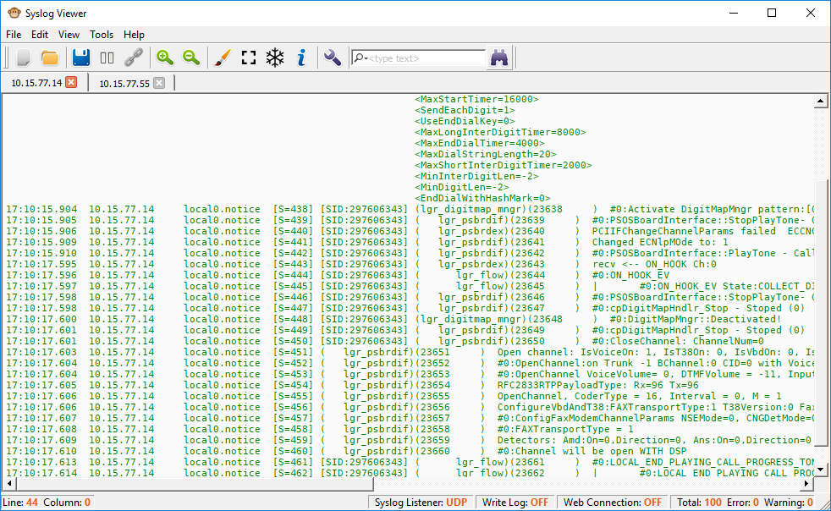
AudioCodes Syslog Viewer
Syslog can be enabled simultaneously in several devices, reporting to the same Syslog Server
Syslog form different IP Addresses can be viewed

Slide 19
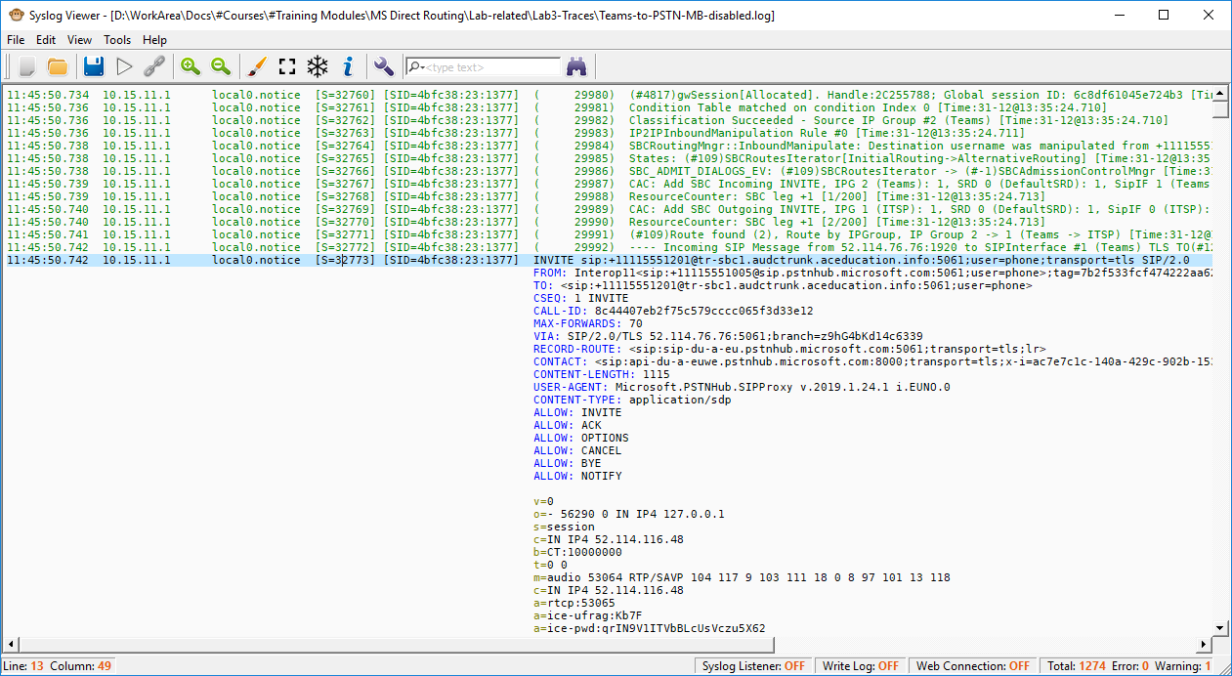
AudioCodes Syslog Viewer
SIP/SDP messages are properly arranged to be easily identified for analysis

Slide 20
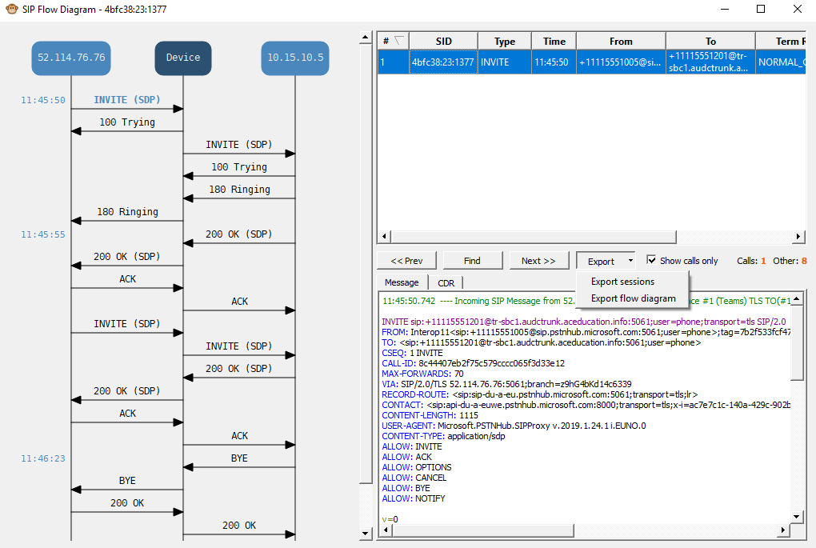
AudioCodes Syslog Viewer
The SIP/SDP flow diagram can be viewed and exported
SIP Flow Diagram

Slide 21
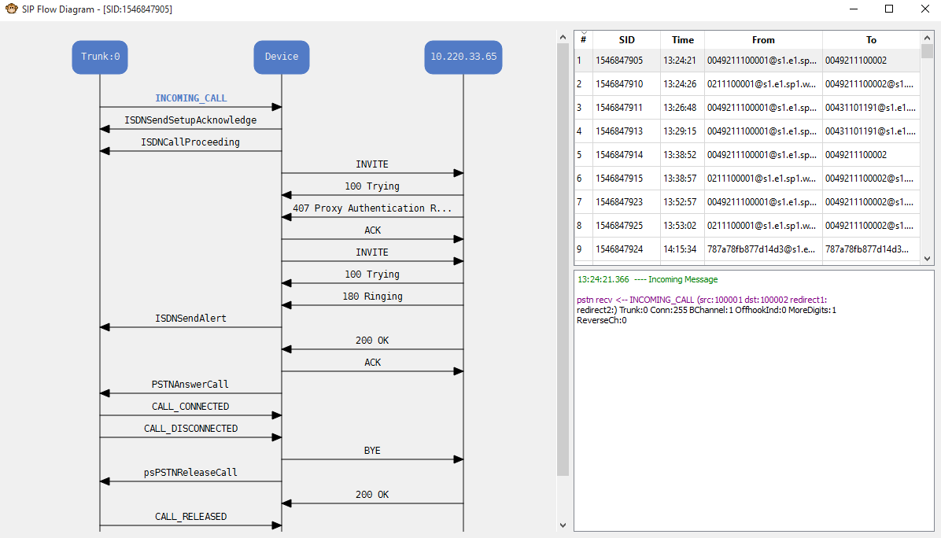
AudioCodes Syslog Viewer
The SIP/SDP <-> ISDN flow diagram can be viewed

Slide 22
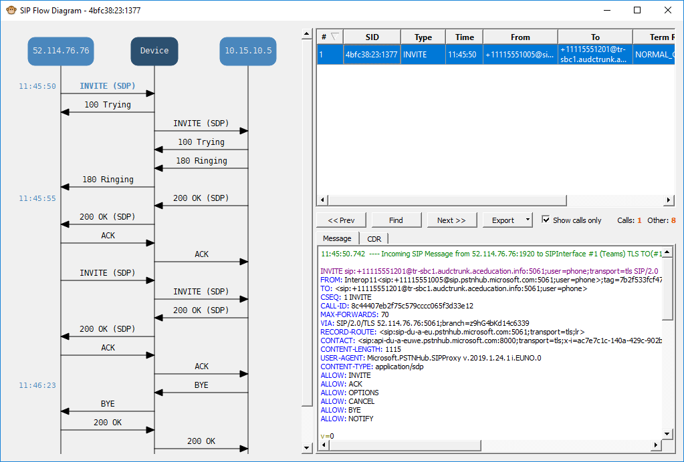
AudioCodes Syslog Viewer
Each arrow on the SIP/SDP flow diagram points to the right place in the trace
Highlighted
SIP Flow Diagram
Points to

Slide 23
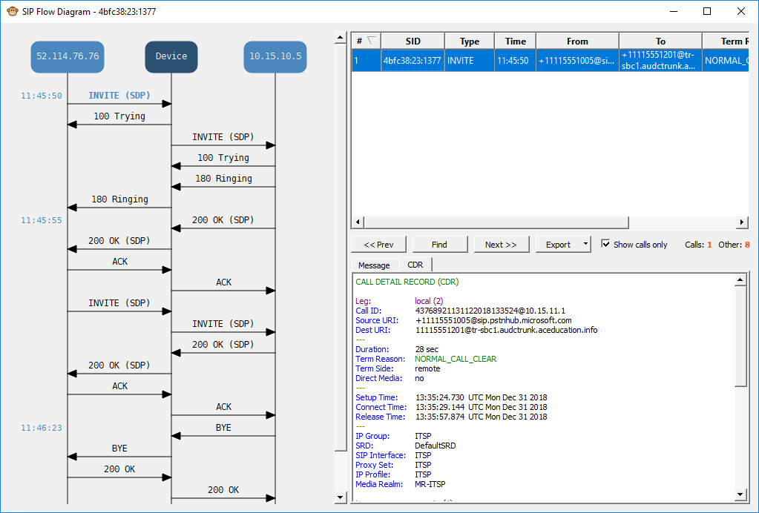
AudioCodes Syslog Viewer
CDR info

Slide 24
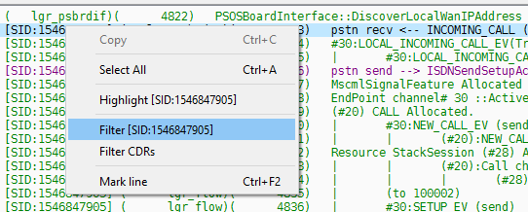
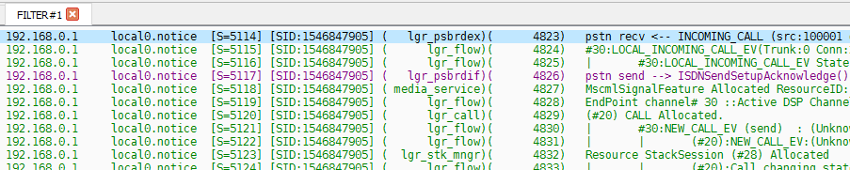
AudioCodes Syslog Viewer
Extracting Single Call

Slide 25
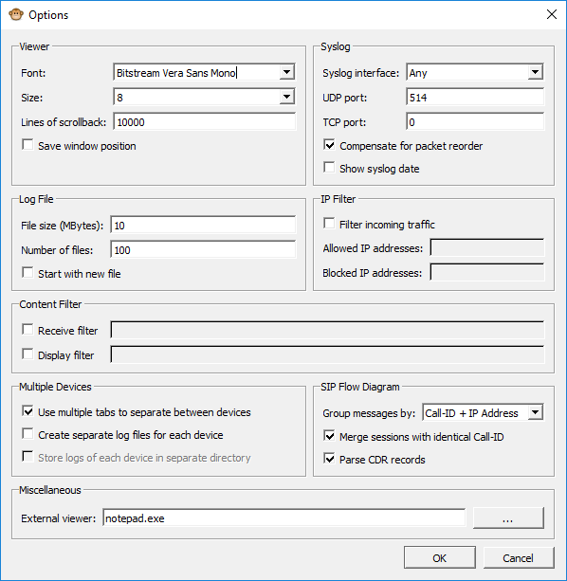
AudioCodes Syslog Viewer
Options

Slide 26
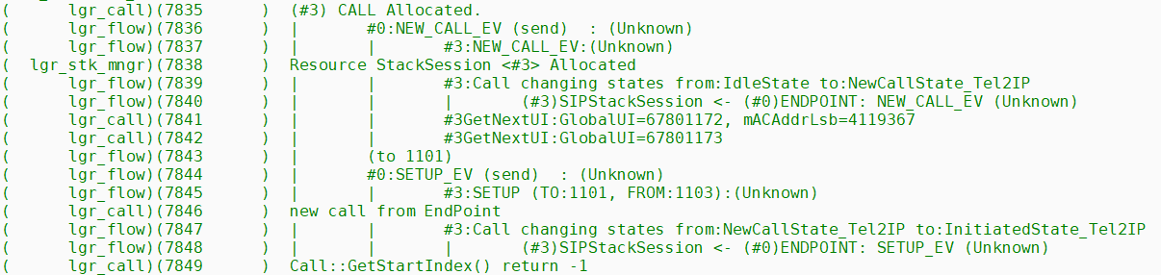
Syslog – Indentation for legacy MPs (6.6)
Three Objects:
Endpoint-------------------Call----------------- Session
Leftmost – Physical Endpoint
First Tab – Board Endpoint (EP)
Second Tab - Call
Third tab - Session
Rightmost - IP
Notes:
Our implementation includes 3 objects that define different aspects of the call: Endpoint (EP), Call and Session.
Endpoint – handles the actual endpoint, usually same as CID
Call – handles the call from infrastructure pointy of view (mostly common to SIP)
Session – handles the call from the protocol side (SIP)
Each call has 3 identification numbers – EP ID, Call ID and Session ID.

Slide 27
The Objects for legacy MPs (6.6)
EndPoint
The logical representation of a channel. Channels may come in various types (analog, digital, conference, bct)
The main functionality of EndPoint is to map global application events into the specific channel logic
Call
The connecting entity between EndPoint and Session
The call establishes synchronization between the two legs
StackSession
The entity which maps application events into the specific Stack (SIP) logic
The StackSession basically represents the connection point to the IP leg
Notes:
Notes:

Slide 28
Notes on Log Objects for legacy MPs (6.6)
Log tabs are denoted by pipe sign (“|”)
Each object is prefixed with a pound sign (“#”)
Board/EP objects are tied to a specific numbering scheme based on the hardware type
MP-11x
#0 represents physical FXO/FXS port 1
Mediant 2000, 3000, 5000
#0 represents physical B-channel 1 on trunk 1
Mediant 1000
Physical Analog ports begin at #0 (range 0-23)
Physical Digital ports begin at #30 (range 30-125)
Call/Session objects are not directly related to any specific port or component in the gateway, but do increment logically
Notes:
Notes:

Slide 29
What do all the tabs mean? (for legacy MPs (6.6))
Call is established by allocating a resource from each object pool on the gateway
For IP → Tel calls the rightmost object is created first
For Tel → IP calls the leftmost object is created first
Each object layer invokes an object from the ‘next’ logical layer
Board/EP object -→ Call Object -→ Session Object → IP
Transition from one object to another represents a passing of messages, states, and information from one side of the gateway to the other (PSTN → IP / IP → PSTN)
Notes:
Notes:

Slide 30
GWApp Events
Mechanism by which the different parts of the application interact
Some parts of the application interact internally with events which are mapped into the application main events before passed to other parts of the application
For example: SIP_ACK_EV is a SIP stack internal event which is mapped to the application CONNECT_ACK_EV
Not all events can be handled by all of the application modules, so if the event will not be processed by a module which can handle it, you will encounter the vague “Unhandled Event…”
“Unhandled events” are not necessarily errors, but simply events that are not handled by that particular application module
Notes:
Notes:

Slide 31
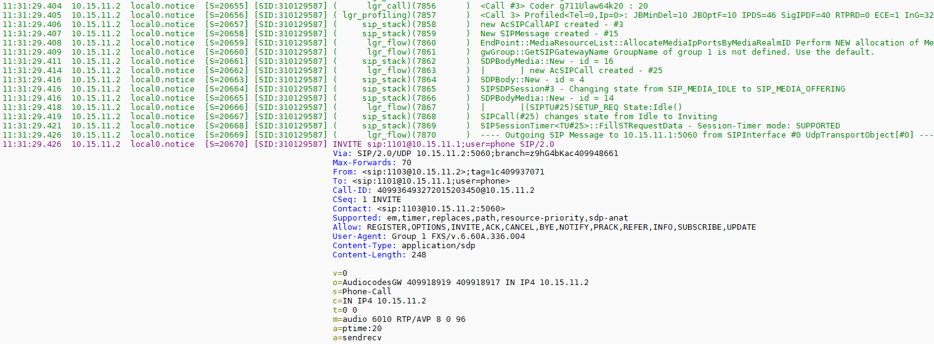
Syslog fields at a Glance
Local PC time
Source Gateway IP Address
Log counter increments by ‘1’ with each syslog that is generated. Resets when gateway is reset
Object identifier
Tab
Source of log on gateway.
Type of log: NOTICE, ERROR, INFORMATION, or WARNING
Unique SIP call session and device identifier
Notes:
Helpful hint – NotePad++ is a downloadable from the internet. It is a free troubleshooting tool which helps view Syslog and other files such as the INI.

Slide 32
Scan for “markers”
Information used to quickly identify what is happening in logs
SIP messaging
DTMF / Digit related events
Endpoint allocation
Routing and Manipulation Actions
Sending and Receiving of PSTN messages
Notes:
Notes:

Slide 33
SIP Messages
Direction of call flow, calling and called party numbers, Display names and vital network information (coders, payload types, ports)
Two call flow direction markers:
---- Incoming SIP Message from 192.168.40.100:5060 ---
---- Outgoing SIP Message to 192.168.40.100:5060 ---
Incoming messages are SIP messages received by the gateway from the SIP network
Outgoing messages are SIP messages SENT by the gateway to the SIP network
Links below highlight the different components of SIP messages that are useful in troubleshooting:
Incoming INVITE indicates an IP to Tel call
Outgoing INVITE indicates a Tel to IP call
Notes:
Notes:

Slide 34
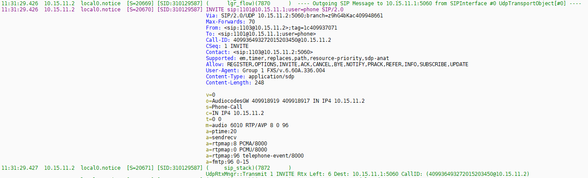
Components to SIP Messages
Indicates direction of the message (incoming or outgoing) and the IP address of the entity the gateway is talking to for this dialog.
In this case it is an outgoing INVITE to a SIP network, therefore the call was originated as a Tel→IP call on the gateway
The gateway will always prepare to retransmit last message in UDP operations. If there is to be a retransmit, the message will retransmit, decrementing the ‘Rtx Left’ counter before resending the message.
Notes:
Notes:

Slide 35
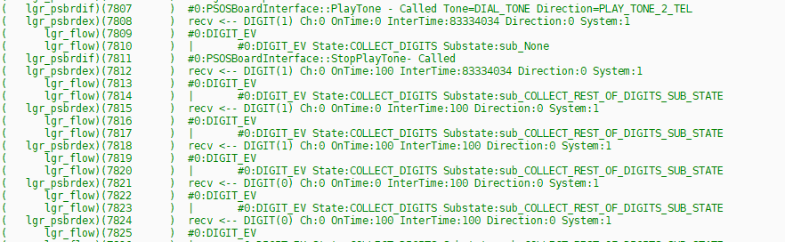
Digit and Dialing Events
‘Digit’ in the log indicates an event on the TEL side
‘recv <-- DIGIT’ indicates a DTMF digit has been received on the TEL side
‘send --> DIGIT’ indicates the gateway is sending a DTMF digit to the TEL side
‘OnTime’ indicates how long DTMF was generated/detected
OnTime:0 – Start of DTMF digit was detected
OnTime:100 – DTMF digit was released – time in milliseconds
Notes:
Notes:

Slide 36
Routing Tel → IP
Tel2IP is the keyword used to indicate Table Tel to IP Routing was used to find the routing destination
FindIPDestination is the keyword for Tel to IP call routing decisions
rmRc:0 (OK) indicates route matching table entry was found
rmRc:5 (FAIL) indicates route matching table entry was not found
Notes:
Notes:

Slide 37
Routing IP → Tel
IP2Tel is the keyword used to indicate Table IP to Trunk/Hunt Group Routing was used to find the routing destination
GetEndPointPhoneNum is a good keyword to use to search for IP to Trunk/Hunt Group routing decisions
GetTrunkGroupId determines if a route was located in the IP to Trunk/Hunt Group table
For Digital trunks, if the gateway finds a match in the routing and trunk groups tables AND there are resources available (Current trunks status) for the trunks associated with the trunk group, the call is passed along
Current trunks status: 1 – Trunk is available
Current trunks status: 0 – Trunk is unavailable
Notes:
Notes:

Slide 38
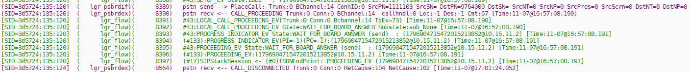
PSTN Messaging Markers
‘pstn recv ←’ indicates an incoming message from the PSTN network to the gateway.
‘pstn send →’ indicates that the gateway is either sending a new call or related message out to the PSTN network
In the example below the message is for a new outgoing call.
Notes:
Notes:

Slide 39
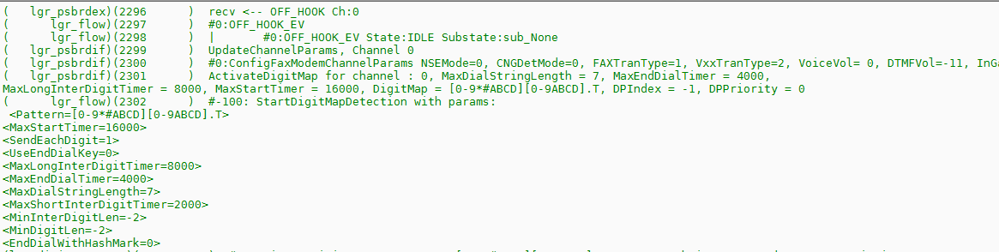
Example Gateway Parameter Usage displayed in Syslog
Max Digits In Phone Number
Inter Digit Timeout (msec)
Dial Plan Index
Digit Mapping Rules
Dial Tone Duration (msec)

Slide 40
Tel → IP Routing Table Flowchart
Incoming call from Tel side of gateway
Route calls AFTER manipulation
Routing mode?
Check Tel → IP Manipulation Tables
Check Tel → IP Routing Table for match
Check Tel → IP Routing Table for match
Route calls BEFORE manipulation
Check Tel → IP Manipulation Tables
Gateway sends outgoing SIP INVITE
Notes:
New for Mediant 2000 and 3000 in release 6.0
Routing IP-to-Tel Calls to Specific Trunk Groups According to CIC Parameter in Request URI:
New in release 6.0, IP-to-Tel routing decisions based on the SIP carrier identification code (CIC) parameter.
It uses the CIC parameter in the incoming SIP INVITE message to route the call to a specific Trunk Group.
SIP CIC enables the transmission of the CIC parameter from the SIP network to the ISDN.
CIC parameter is a three- or four- digit code used in routing tables to identify the network that serves the remote user when a call is routed over many different networks.
CIC parameter is carried in SIP INVITE and maps to the ISDN Transit Network Selection Information Element (TNS IE) in the outgoing ISDN Setup message (if the EnableCIC parameter is set to 1).
TNS IE identifies the requested transportation networks and allows different providers equal access support, based on customer choice.
To support this feature, the new parameter, AddCicAsPrefix. When this parameter is enabled, the device adds the CIC prefix to the destination number (for IP-to-Tel calls).
Note: After the CIC prefix is added, the IP-to-Trunk Group Routing table can be used to route this call to a specific Trunk Group. The Destination Number IP to Tel Manipulation table must be used to remove this prefix before placing the call to the ISDN.
Relevant parameter: AddCicAsPrefix
Determines whether to add the Carrier Identification Code (CIC) as a prefix to the destination phone number for IP-to-Tel calls.
[0] No (default)
[1] Yes

Slide 41
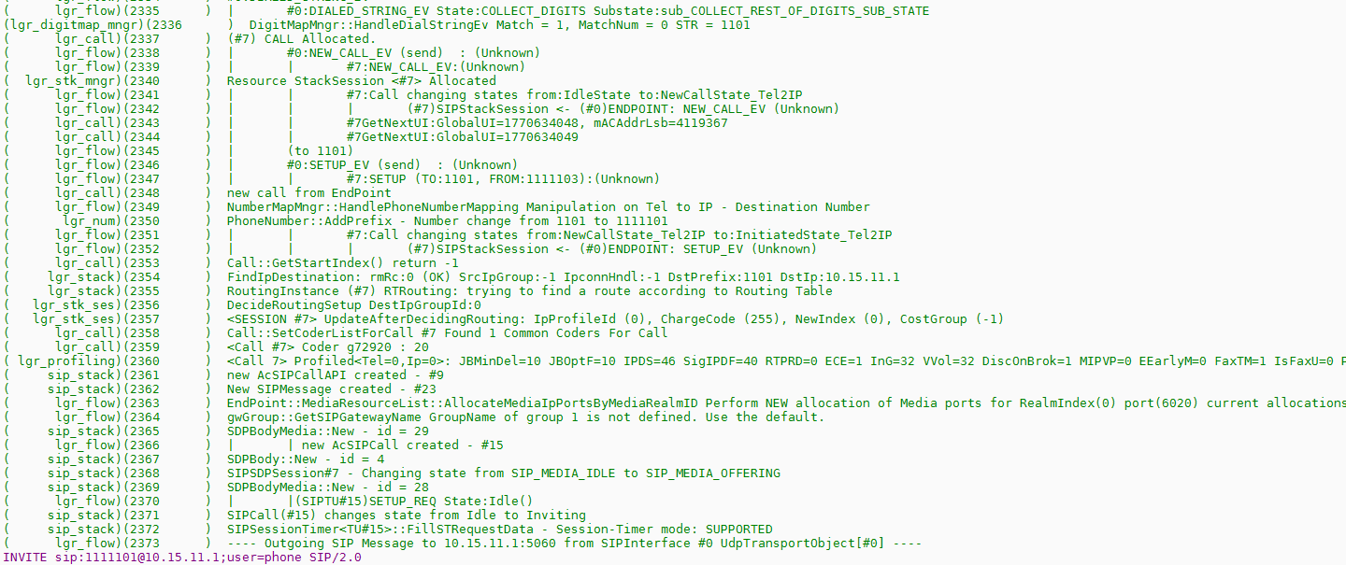
Example Gateway Table Usage displayed in Syslog
Destination Number Tel to IP Manipulation Table
IP to Trunk/Hunt Group Table
Coder Group Table
IP & Tel Profile Tables
Media Realm Table

Slide 42
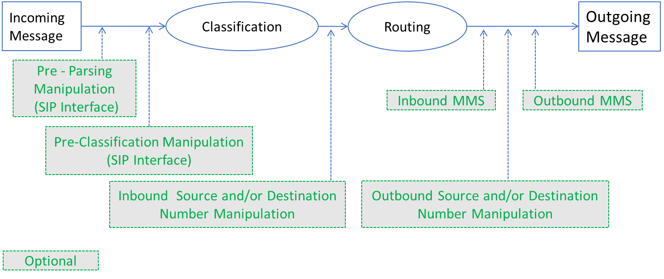
Session Border Controller (SBC) logs
Session Border Controller uses CMR Process to handle Call flow across legs on the SBC
C = Classify
M = Manipulate
R = Route
This call flow is demonstrated in the SBC Syslogs

Slide 43
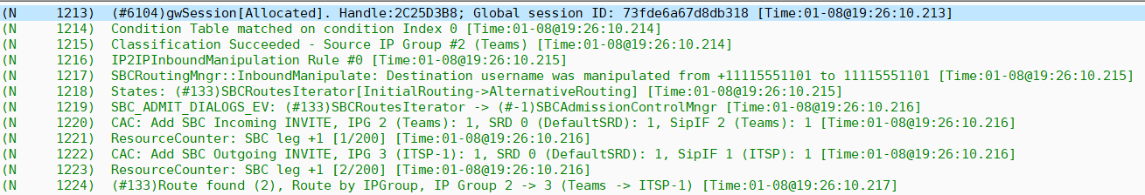
SBC CMR Process Identified
Classify
Manipulate
Route

Slide 44
Entities and Tables Relations
SRD
Multiple SIP Interfaces per IP Interface
Multiple SIP Interfaces per SRD
Multiple IP Groups per SRD
Multiple Proxy Sets per SRD
Multiple Classification Rules per SRD
Multiple SRDs per Routing Policy
IP Interface
SIP Interface
IP Group
Proxy Set
Classification Rule
Routing Policy
Multiple IP Groups per Proxy Set
Ethernet Devices
Multiple Media Realms per IP Interface
Multiple SIP Interfaces per Media Realm
Multiple Routing Rules per Routing Policy
Multiple Inbound Manipulations per Routing Policy
Ethernet Groups
Media Realm
Multiple Outbound Manipulations per Routing Policy
Physical Ports
IP-to-IP Routing Table
IP-to-IP Inbound Manipulation Table
IP-to-IP Outbound Manipulation Table
Notes:
As we already mentioned the SIP Interface is “functioning“ as SRD in the previous release.
This is why we can see as an example that the media realm is configured per SIP Interface and not per SRD as well as the SIP Interface
and not the SRD, is assigned to the Classification Table and to the IP-to-IP Routing Table.
On the right side we can see the tables pointing the new added Routing Policy Table.

Slide 45
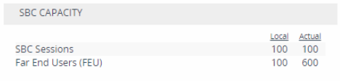
SBC CMR Process Identified – Deep Dive
4 Step Classification Process
Address of Record
Classify by Proxy Set
Classification Table – can use Message Condition Table
Allow Unclassified Calls
Message Condition Table
Inbound Number Manipulation
Classification Table
Incoming Leg
IP to IP Routing table – Checking Alternative Route Options Column – Route Row, Alternative Route Ignore Inputs, etc
Outgoing Leg
IP to IP Routing Table entry used to route call – Index number from table displayed
SBC Legs allocated vs Total SBC Sessions x2
(Logical Crossconnect)
Indicates status of IP Group, SRD, SIP Interface
0 – Not Connected
1 - Connected

Slide 46
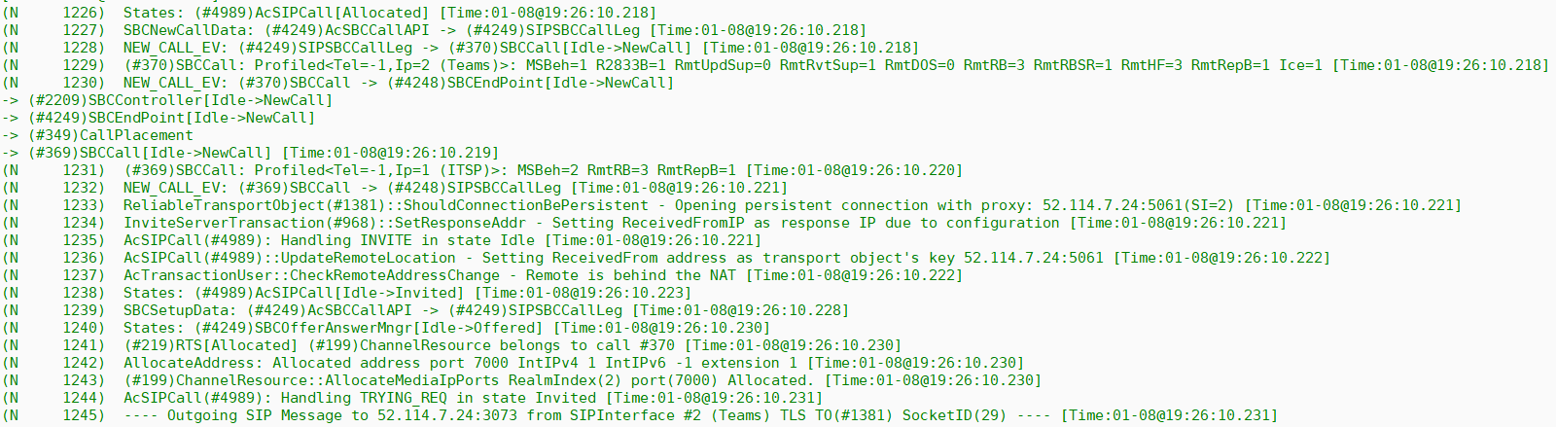
SBC CMR Process Identified – Deep Dive
Incoming IP Profile
.
.
.
Outgoing IP Profile
Received IP from Leg 1
SIP Interface Table Index number
Checking for NAT on Leg 1 – Parameter SIP NAT DETECTION
Allocating RTP/UDP Port for SIP Response to Invite on Leg 1 – allocated from Media Realm
NOTE: The NAT Detection mechanism checks whether the endpoint is located behind NAT by comparing
the source IP address of the incoming UDP/TCP packet (in which the SIP message is received)
with the IP address in the SIP Contact header. If the packet's source IP address is a public address
and the Contact header's IP address is a local address, the device considers the endpoint as
located behind NAT.

Slide 47
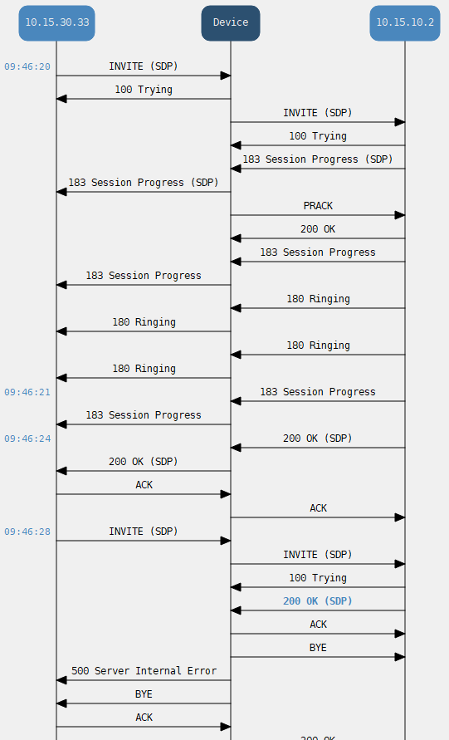
Error Analysis
Scenario: Music on Hold Call to Skype for Business from IP-PBX fails with Media Mismatch
Original Invite to SBC from IP-PBX advertises
m=audio 6080 RTP/AVP 9 8 0 101
Invite Traverses SBC to Skype advertises
m=audio 6310 RTP/AVP 9 0 101
200 OK from Skype advertises
m=audio 53656 RTP/AVP 0 101
200 OK to IP-PBX advertises
m=audio 6570 RTP/AVP 9 101
Call established
Re-Invite from IP-PBX to SBC advertises
m=audio 6080 RTP/AVP 9 8 0 101
a=sendonly
Re-Invite from SBC to Skype advertises
m=audio 6310 RTP/AVP 9 8 0 13 101
a=inactive
200 OK from Skype advertises
m=audio 53656 RTP/AVP 8 13 101
a=inactive
SBC sends Skype a BYE and IP-PBX a 500 Internal Server Error
g.711µlaw
g.722
g.722
g.711Alaw

Slide 48
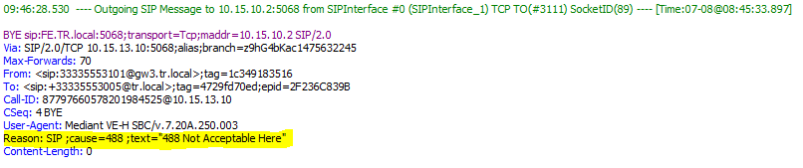
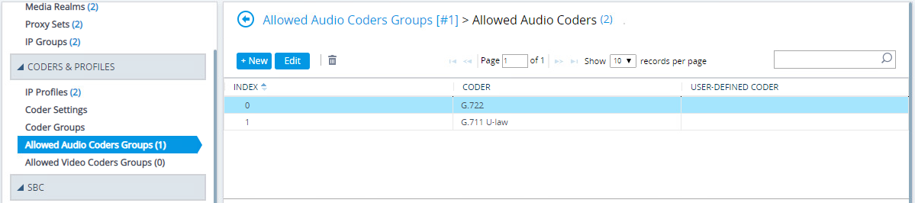
Error Analysis
Skype tried to renegotiate the media at G.711Alaw instead of using what had been negotiated as G.711µLaw because a message manipulation was added that modified the SDP
It was found that the Allowed Coder Group table was removing the payload type 8 (g.711Alaw) from the incoming Invite from the IP-PBX, this caused the call to fail
(#220)SBCCall: Profiled<Tel=-1,Ip=0 (ITSP)>: ExtCGrp=1 AllCGrp=1 MSBeh=2 R2833B=1 AltDM=2 MltDTMF=1 AssrtID=1 2833PT=101 [Time:07-08@08:45:25.815]

Slide 49


Allowed Coders – Incoming Offered
At least one incoming coder must be in the Allowed Coders Group
Either for a request and/or a response
Typically the Allowed Coder Group would remove the Codec not on the list, but a message manipulation was used that modified the SDP
G.722 + G.711Alaw + G.711µLaw
G.722 +
G.711µLaw
Group 2
Allowed Coders Group contains:
G.722
G.711µLaw
Call Dropped
G.711Alaw
Group 2
Allowed Coders Group contains:
G.722
G.711µLaw
Analyze the log!

Slide 50

Other Syslog Applications
Examples of Syslog servers available as shareware:
Kiwi Enterprises: http://www.kiwisyslog.com/
The US CMS Server: http://uscms.fnal.gov/hanlon/uscms_server/
Netal SL4NT Syslog Daemon: http://www.netal.com
For additional information, refer to www.Syslog.org
a site dedicated to helping to understand and implement logging and analysis systems
Notes:
Notes:

Slide 51
Notes
Notes:
Notes:

